Slide 1
Singleness
A Discovery Workshop –
The God Who Sees

Slide 2
Singleness
SINGLENESS definition: the state or quality of being single
One that is separate and individual

Slide 3
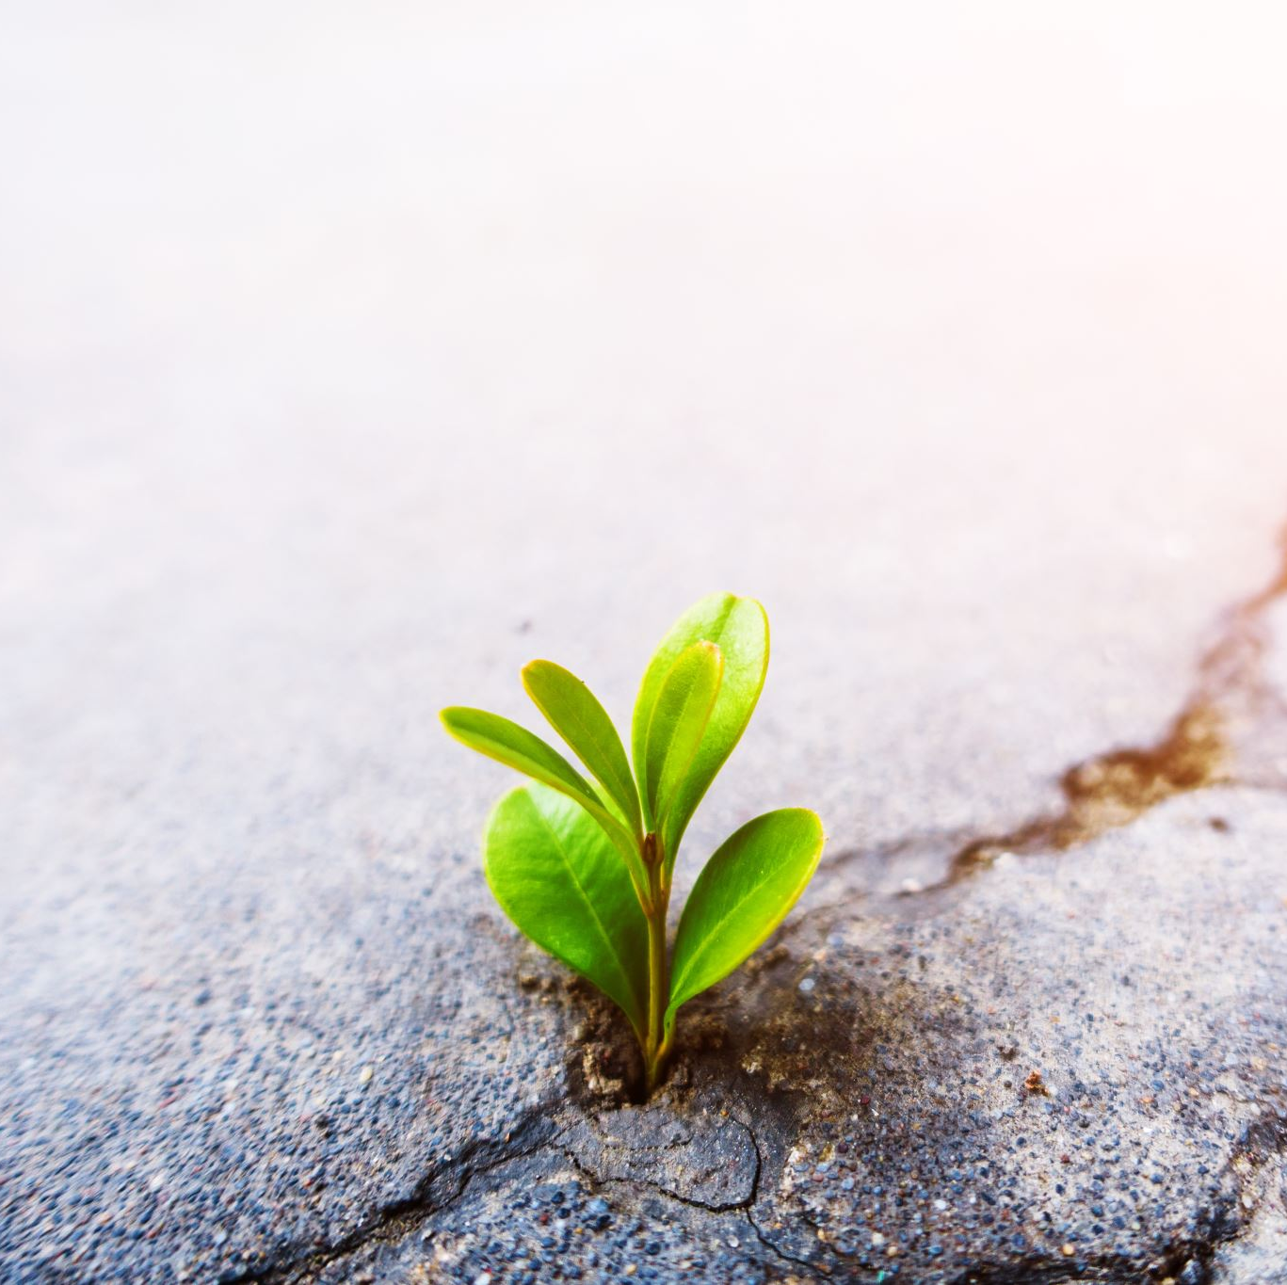
Single/ness
Is often for a variety of reasons e.g.
Choice
Lack of opportunity
Divorce
Death – widow or widower

Slide 4
The God Who Sees
(1103) The God Who Sees OFFICIAL Lyric video – YouTube

Slide 5
Singleness in scripture
Hebrews 13:5: Be content with what you have, for God will never leave you nor forsake you.
Proverbs 31:30: A woman who fears the Lord is to be praised, regardless of her charm or beauty.
Romans 12:1: Offer your body as a living sacrifice to God, which is your true and proper worship.

Slide 6
Scripture on singleness
1 Corinthians 7:8: It is good for the unmarried and widows to remain single, as Paul did.
1 Corinthians 7:32-35: Singleness allows you to care for the things of the Lord and serve Him without distraction.

Slide 7
Great text
Hosea 2:19-20 ESV
And I will betroth you to me forever. I will betroth you to me in righteousness and in justice, in steadfast love and in mercy. I will betroth you to me in faithfulness. And you shall know the Lord.

Slide 8
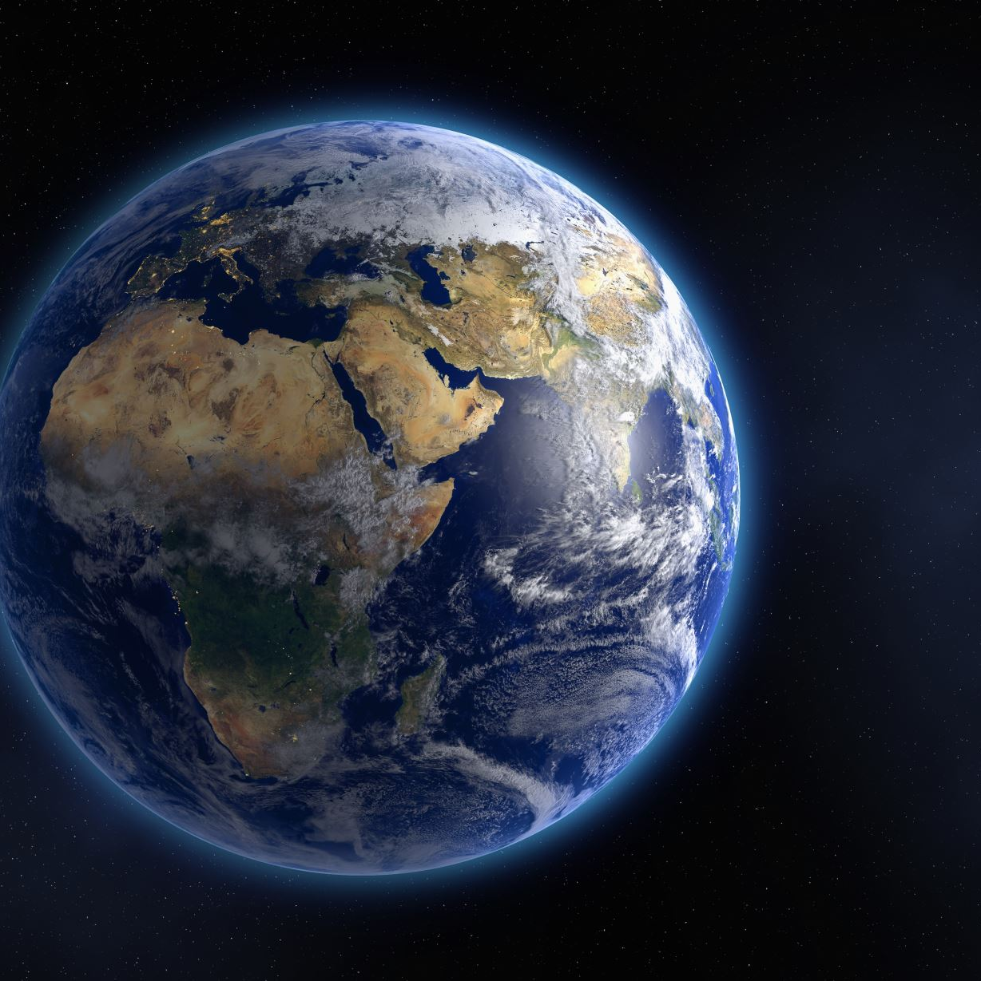
My favourite text on singleness is
Isa 54:5
New King James Version For your Maker is your husband, The LORD of hosts is His name; And your Redeemer is the Holy One of Israel; He is called the God of the whole earth.

Slide 9
Testimony - living as a single person
How I survive as a single person
Having a devotional life
Read/bible study and journalling
Sustained prayer life/journalling
Writing
Becoming involved in ministry

Slide 10
Hobby and other interest
Reading and baking
Looking after yourself
By checking on my emotions
Eat well
Exercise and massage monthly

Slide 11
Knowing when to clear or change the atmosphere in the home:
Music
Different types of music
Dancing
Listening to encouraging sermons and stories
Prayer focus

Slide 12
Discussion Time?
How do you survive as single person after death of partner?
How do you survive as single person after the death of a marriage?
How do you survive after leaving a long-term relationship?
How do you deal with sexual urges?

Slide 13
How do you want to live in this season of singleness?
What do you want God to do for you?
https://www.bing.com/search?q=your+goodness+is+running+after+me+cece+winans&qs=RI&pq=goodness+is+running+after+me+

Slide 14
In everything you are going through remember
God Sees You and he experiences everything with you.

